Slide 1
Week 3 James 1:19-2:13 April 17, 2016

Slide 2
Quick to listen
Be careful what you say when emotions are involved
Quiet time to spend in intrapersonal
Always listen more than you talk
Never use words that hurt
Never take the name of the Lord in vain

Slide 4
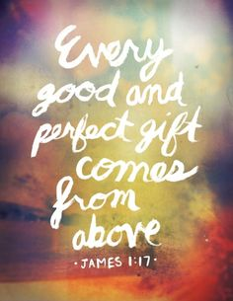

Slide 5
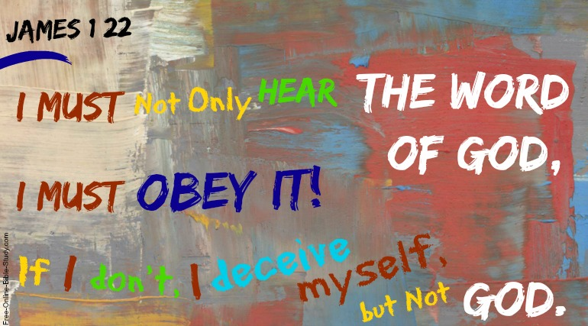

Slide 6
“Well done is better than well said.”

Slide 7
“the single most cause of atheism in our world today is Christians…who acknowledge Jesus with their lips…but walk out of the church doors and deny him with their lifestyle. This is what an unbelieving world simply finds unbelievable.”

Slide 8
I. Followers of Jesus are people of control

Slide 9
II. Followers of Jesus are people of conviction

Slide 10
III. Followers of Jesus are people of compassion

Slide 11
Chapter 2:1-13 Favoritism: preferential treatment

Slide 12
Is favoritism ever OK?

Slide 13
Why favoritism is wrong:
1. Inconsistent with God’s method. vs 5
2. It is inappropriate given the conduct of the rich. vs. 6-7
It is indifferent to the principle of mercy. vs. 8-11

Slide 14
What are practical examples of showing mercy today?

